Slide 1
Uber Supply-Demand Gap Case study
By:
Asha Solanki

Slide 2
Uber Supply-Demand Gap Case study
Business Understanding:
You may have some experience of travelling to and from the airport. Have you ever used Uber or any other cab service for this travel? Did you at any time face the problem of cancellation by the driver or non-availability of cars?
Well, if these are the problems faced by customers, these very issues also impact the business of Uber. If drivers cancel the request of riders or if cars are unavailable, Uber loses out on its revenue. Let’s hear more about such problems that Uber faces during its operations.
Problem statement:
Uber is facing - driver cancellation and non-availability of cars leading to loss of potential revenue.
Business Objectives
The aim of analysis is to identify the root cause of the problem (i.e. cancellation and non-availability of cars) and recommend ways to improve the situation. As a result of your analysis, you should be able to present to the client the root cause(s) and possible hypotheses of the problem(s) and recommend ways to improve them.
Note :
For this analysis, only the trips to and from the airport are being considered

Slide 3
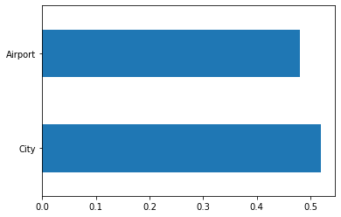
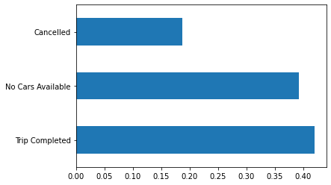
Univariate Analysis of “Pickup point” & “Status” Column
Analysis of Pickup point based on Number of request shows both the location have almost equal number of request
City : 52%
Airport : 48%
Analysis of Status column based on Number of request shows Trip completed and No Cars available have equal numbers and Cancelation count is also high
Trip Completed : 42%
No Cars Available : 39%
Cancelled : 19%

Slide 4
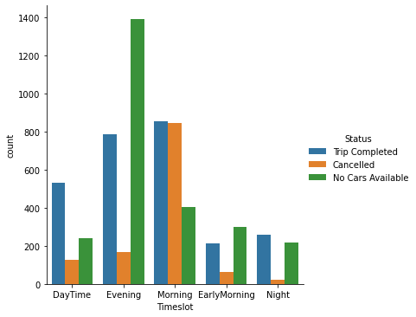
Analysis of time slot verses status
Analysis shows more request is coming for Morning & Evening timeslot and below is the observation:
For Evening slot : No cars available count is almost doubled than Trip Completed
For Morning slot : Trip Completed and Cancelled count is same

Slide 5
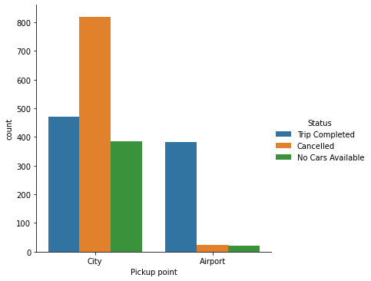
Analysis of Morning Time Slot
Analysis is as below
Pickup point as City
Overall supply count is 1677
It shows cancelation rate is high for city which is 820
Trip completed count is 472
Pickup point as Airport
Overall supply count is 426
Cancelled Trip count is 23
Trip completed count is 382

Slide 6
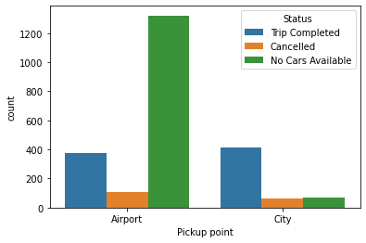
Analysis of EveningTime Slot
Analysis is as below
Pickup point as Airport
Overall supply count is 1800
It shows No Cars available rate is high for Airport which is 1321
Trip completed count is 373
Pickup point as City
Overall supply count is 542
It shows cancelation count is 60
Trip completed count is 411

Slide 7
Possible solutions and recommendations
Provide incentives for airport trips during peak time.
Assign dedicated cabs for airport during peak time
Fixing a base price for drivers idle time in the airport or to come back to the city without any passenger.
Promote advance flight booking option for passenger which will help both passenger and driver to mange the timing
Set limit for cancelation of trip for driver.

